Slide 1
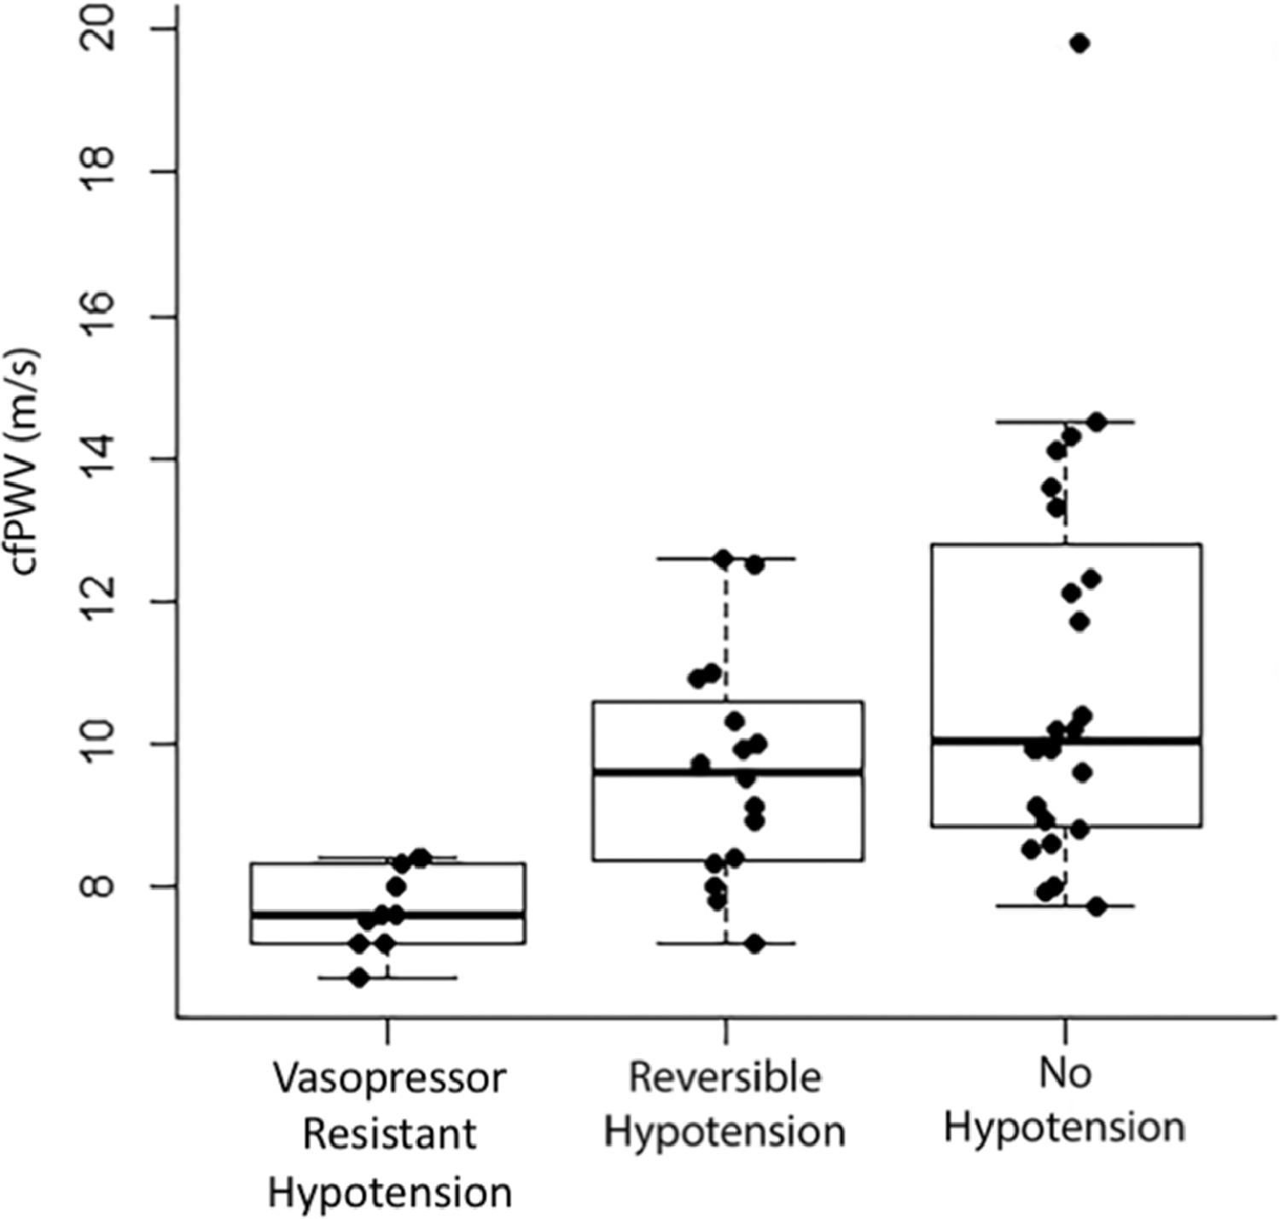
Arterial Stiffness Predicts Response to General Anesthesia
 |  | No Vasopressor Resistant Hypotension
 | Vasopressor Resistant Hypotension (n=10) | Reversible Hypotension (n=16) | No Hypotension (n=24) | P-value
Brachial SBP (mmHg) | 124(17) | 132(18) | 143(21) | 0.02
Brachial DBP (mmHg) | 70(8) | 71(8) | 72(11) | 0.94
HR (beats/min) | 72(11) | 71(8) | 75(14) | 0.52
cfPWV (m/s) | 7.6(7.2-8.3) | 9.6(8.3-10.8) | 10.1(8.8-13.1) | 0.001
Phenylephrine does (mcg) | 450(375-725) | 100(100-175) | 0(0-0) | <0.001
cf-PWV was assessed in 50 patients being chronically treated with ACE inhibitors prior to general anesthesia
Patients who developed vasopressor resistant hypotension (VPH) demonstrated significantly lower cf-PWV values than those who did not
Given the increased perioperative morbidity associated with VPH, use of cf-PWV may help identify high risk patients and allow for better preparation ahead of general anesthesia
Ueda, K. et al. J Cardiothorac Vasc Anesth 2020 Aug 22; S1053-0770(20)30834-X. epub ahead of print.
Notes:
Research has shown that patients chronically taking angiotensin-converting enzyme inhibitors (ACEI) are more prone to developing hypotension after induction of general anesthesia, which in some cases involves patients aren’t responsive to vasopressor therapy. This study sought to examine whether pre-operative carotid-femoral pulse wave velocity (cf-PWV) may be significantly lower in patients chronically treated with ACEI’s who experience vasopressor resistant hypotension (VRH) than those who do not. Results showed that, indeed, patients who developed VRH had significantly lower cf-PWV that those who did not. With each 1 m/s decrease in cf-PWV there 62% increased odds of developing hypotension and an expected 40% increase in phenylephrine dose. These findings suggest that pre-operative cf-PWV assessment may help identify and prepare patients at high risk of developing VRH.

